Slide 2
Botanical Tours as an education and promotional tool
Rossen Vassilev
Bulgarian Biodiversity Foundation

Slide 3
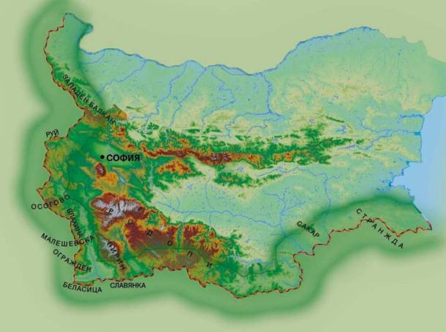
The Flora of Bulgaria
More than 4100 plant species
Including 302 Balkan endemics and 197 Bulgarian endemics
Living in 542 different habitats

Slide 4
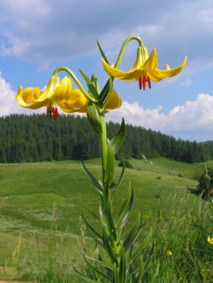
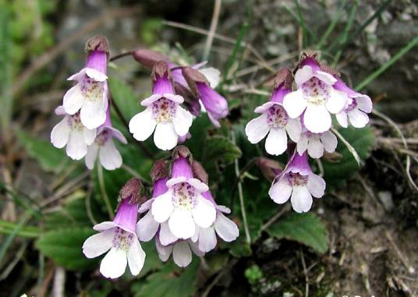
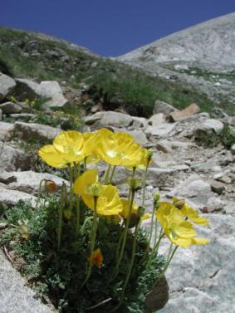
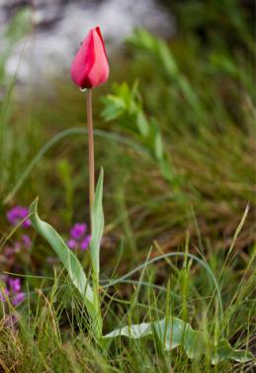
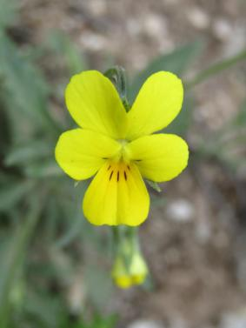
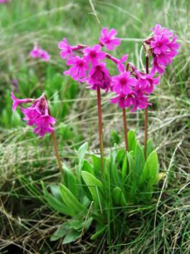
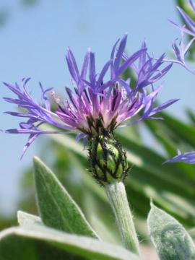
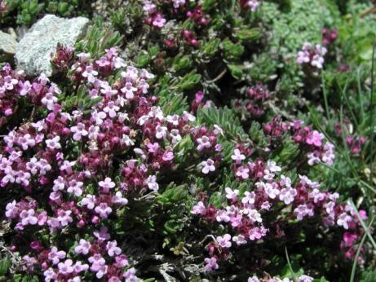

Slide 5
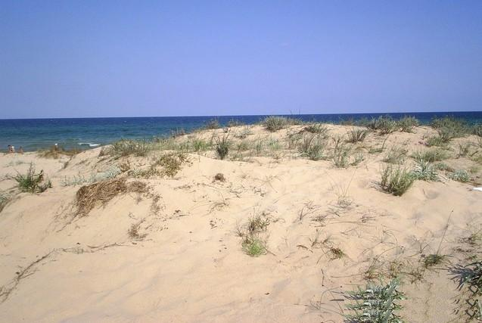
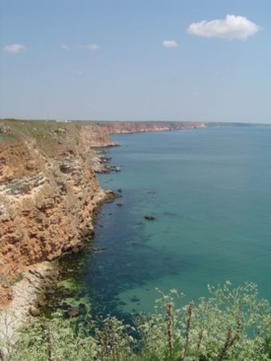
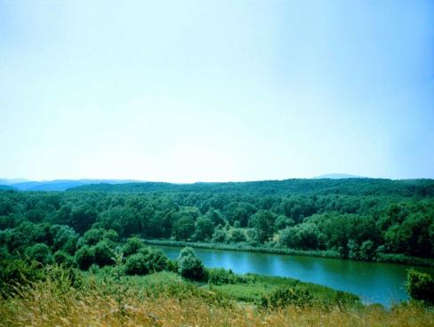
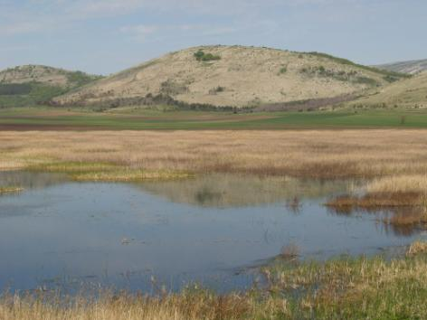
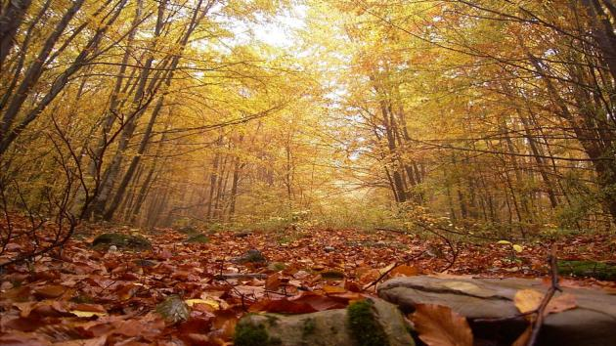
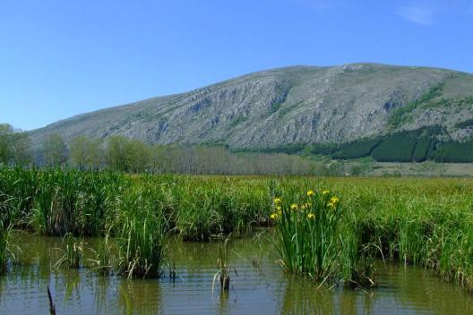
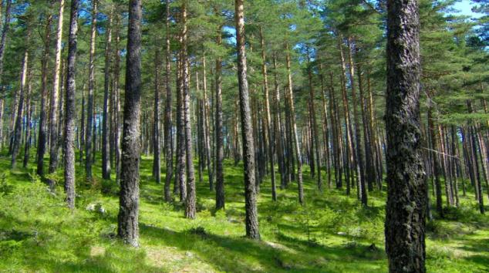

Slide 6
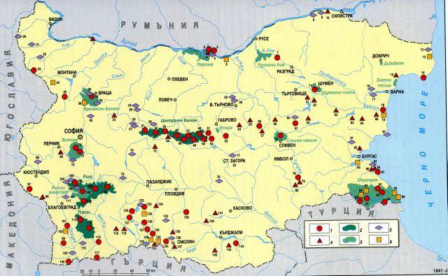
Nature conservation
Protected species
Protected territories

Slide 7
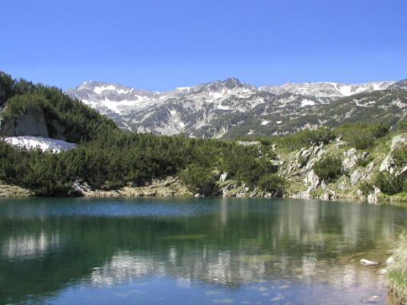
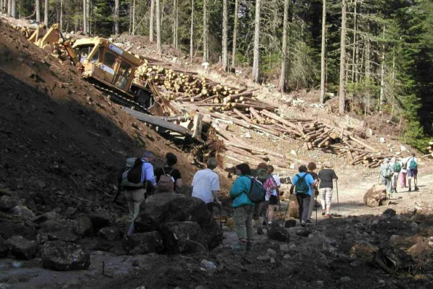
Pirin National park

Slide 8
Eco-tourism and observation of plants
Guided tours for foreign visitors
Increasing interest of Bulgarian public
Tour-operators offering specialized tours

Slide 9
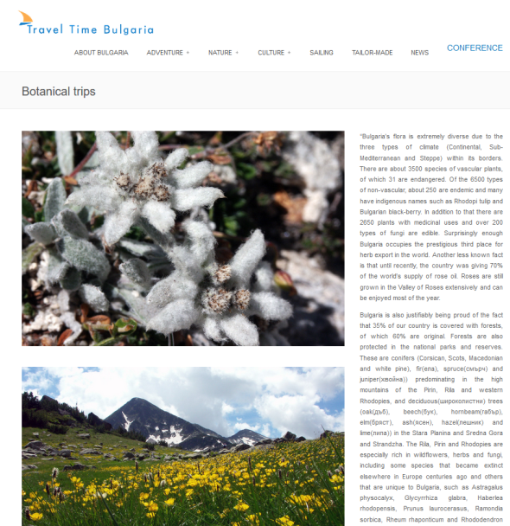
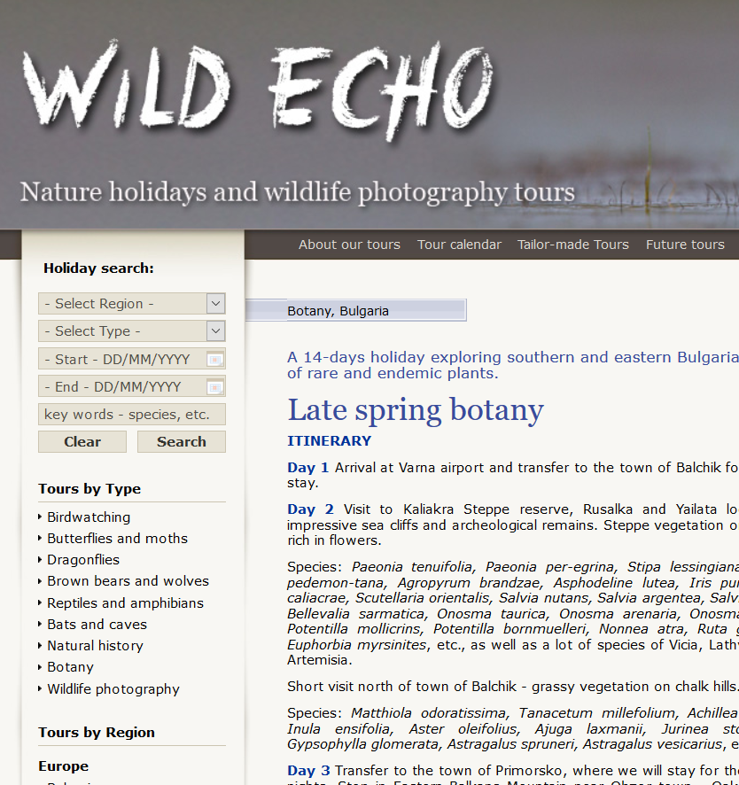

Slide 10
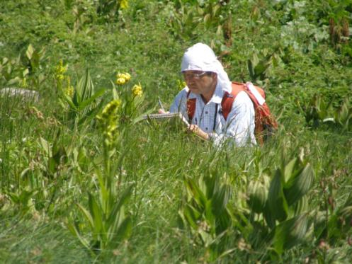
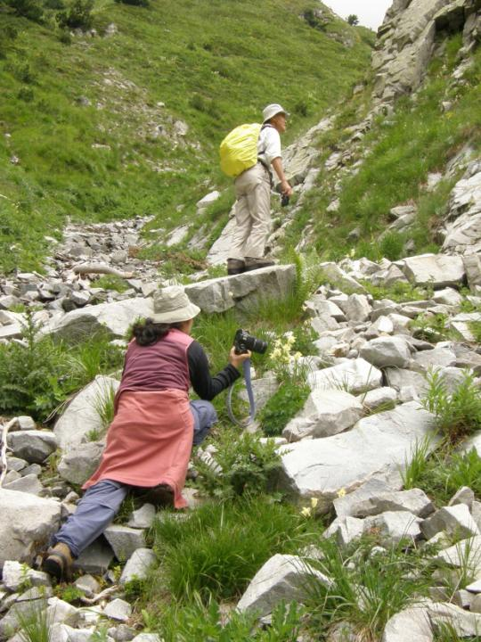
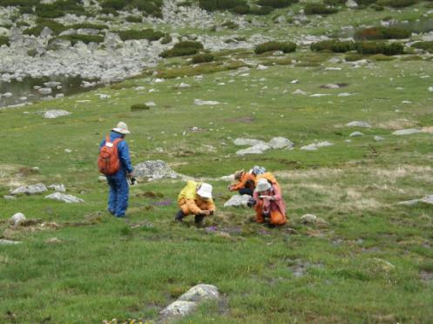

Slide 11
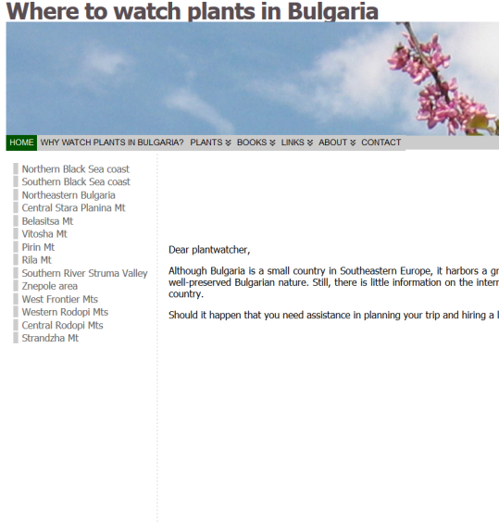
http://plantwatching.com/

Slide 12
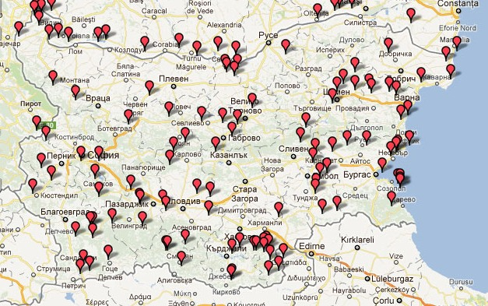
Important Plant Areas

Slide 13
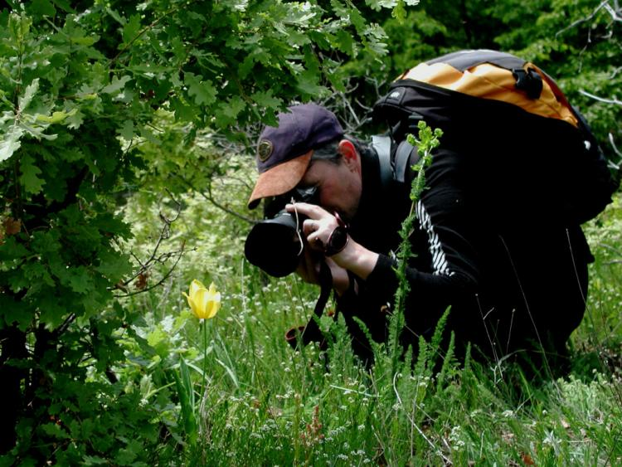
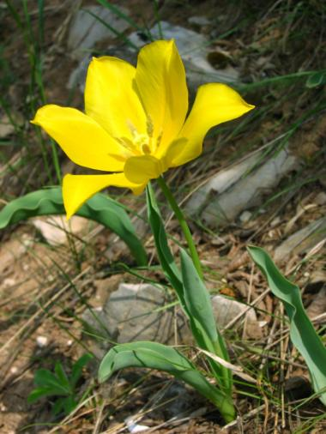
Tulipa urumoffii

Slide 14
Epipactis sp.

Slide 15
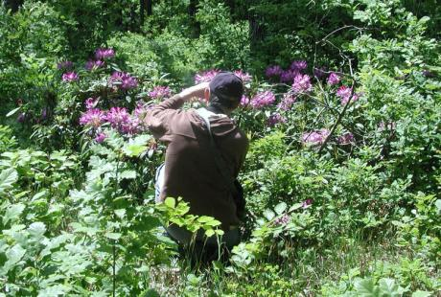
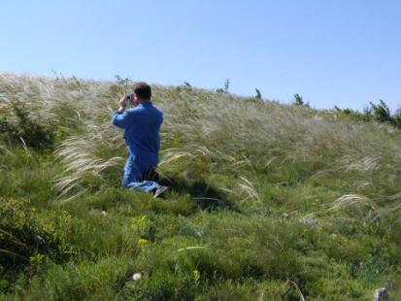
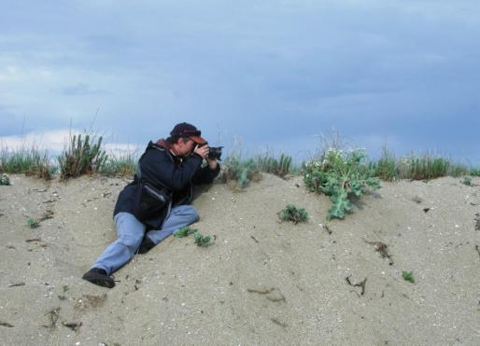
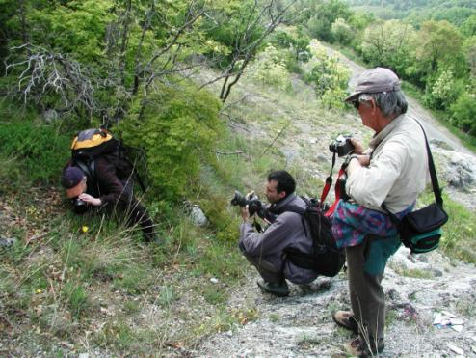
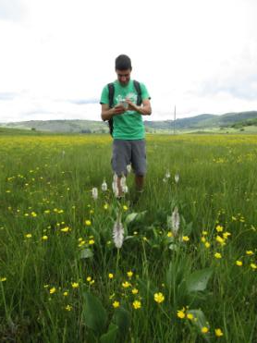

Slide 16
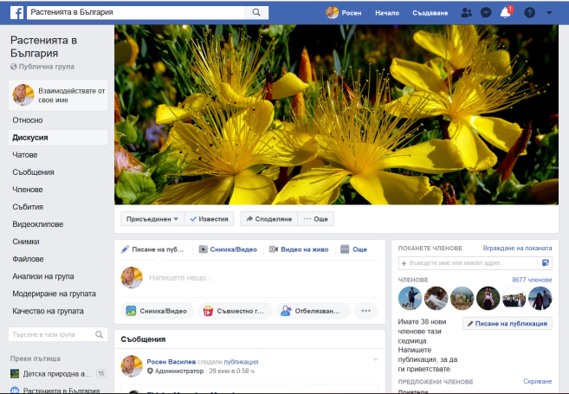
Citizen science
Facebook groups
Meetings and excursions
Monitoring and publications

Slide 17
BBF experience
Publications
Education for children
Botany lectures for amateurs
Traveling botanical seminars

Slide 18
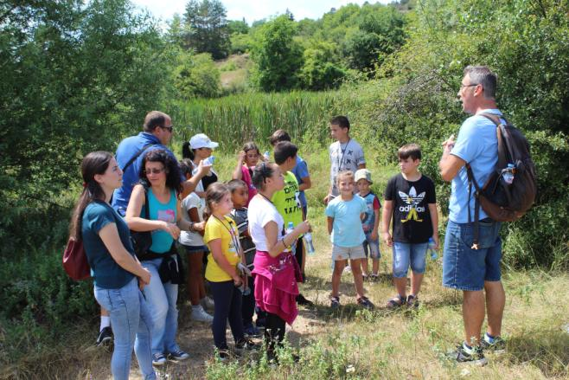

Slide 19
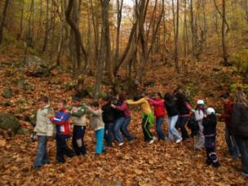
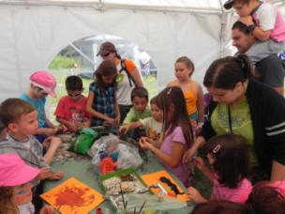
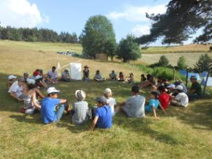
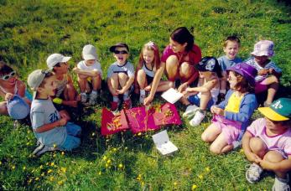
Children Nature Academy Uzana

Slide 20
Year of the plants

Slide 21
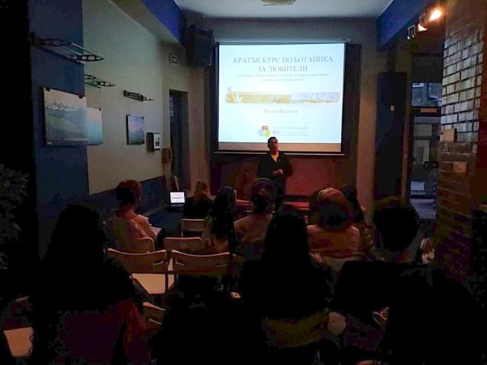
Botanical lectures
Two amateur groups in 2018
One group 1st level and one group 2nd level in 2019

Slide 22
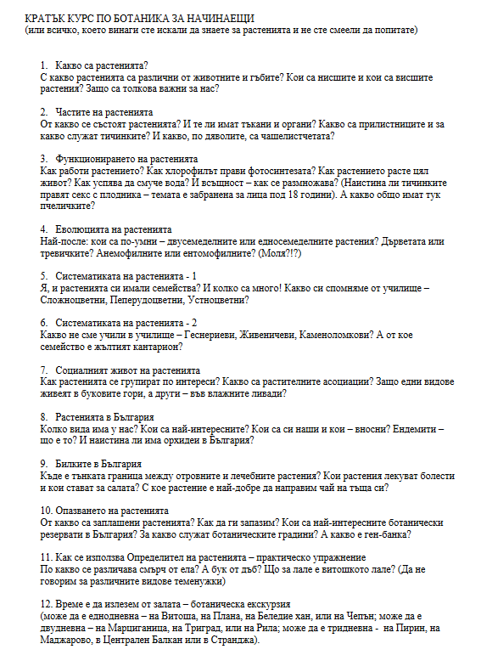
The content
What are the plants?
The parts of the plants
The functioning of the plants
The evolution of the plants
The systematics of the plants
The social live of the plants
The plants in Bulgaria
The medicinal plants in Bulgaria
The protection of the plants
How to use an identification guide – practical exercise
Let’s go out – botanical excursion

Slide 23
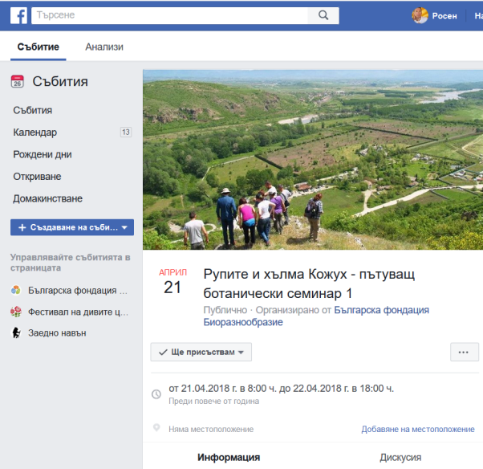
Botanical seminars
Rupite and Kozhuh (April 2018)
Sakar and Strandzha (May 2018)
Beledie han (June 2018)
The steppes of Kaliakra (June 2019)
The ridge of Belasitsa (July 2019)

Slide 24
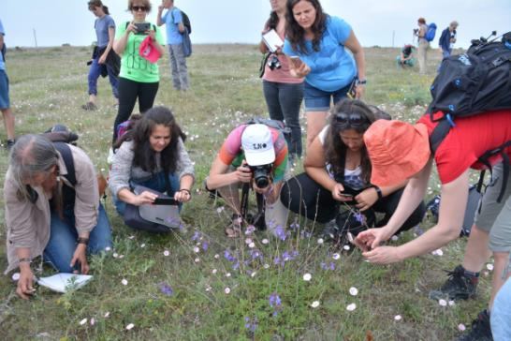
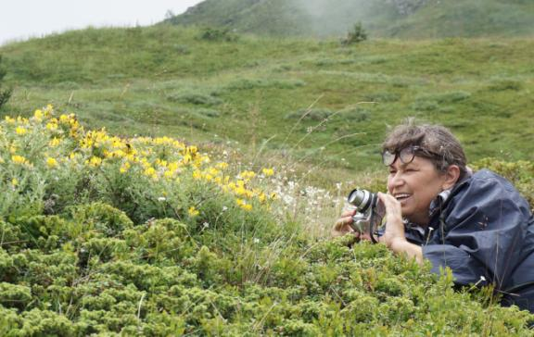
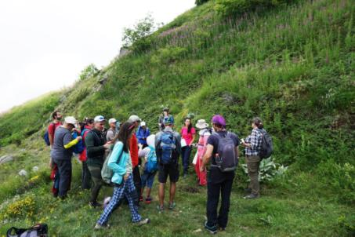
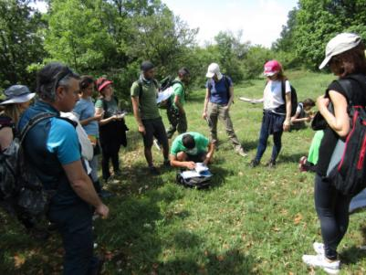
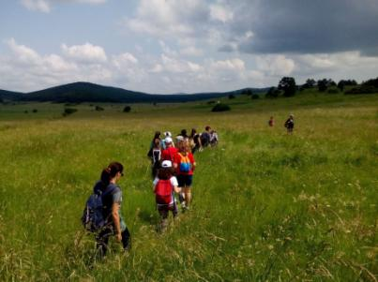
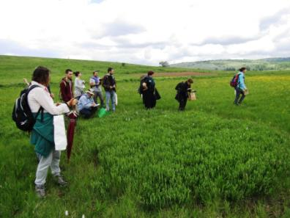

Slide 25
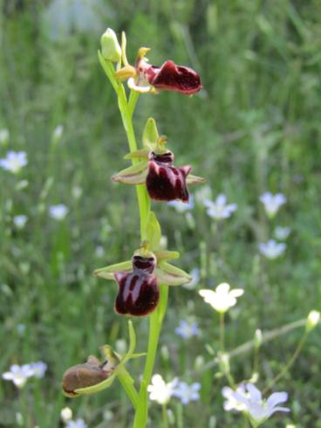
Ophrys mammosa

Slide 26
Why we are doing this?
Non-formal education
Promotion of eco-tourism opportunities
Nature conservation messages

Slide 27
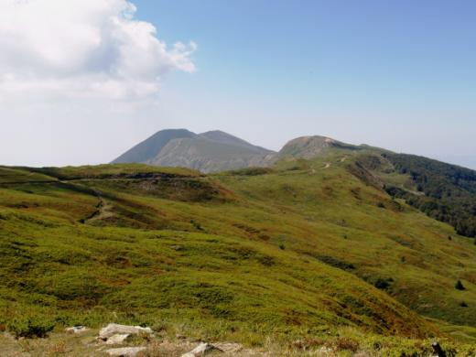
Belasitsa Nature park

Slide 30
Thank you!

