Slide 2
Sustainable tourism – mission possible!
Eleonora Yosifova
Bulgarian Association for Alternative Tourism

Slide 3
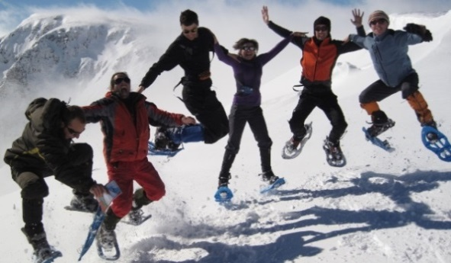
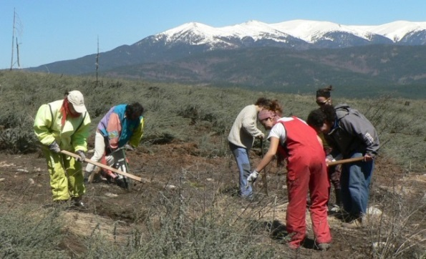
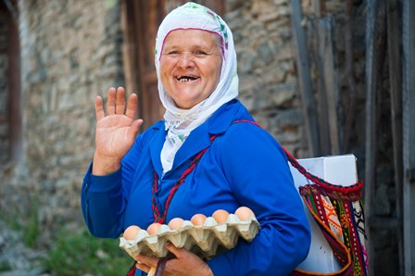
What is sustainable tourism?
Economic viability
Local prosperity
Employment quality
Social Equity
Visitor Fulfillment
Local Control
Community Wellbeing
Cultural Richness
Physical Integrity
Biological Diversity
Resource Efficiency
Environmental Purity

Slide 4
3 P: People, Planet, Profit
Product with minimal impact on the environment
Support for the protection of the cultural and natural heritage of the visited region
Contributing to the social and economic development of local communities
We need to manage all tourism resources in a way that ensures their protection and long-term use.

Slide 5
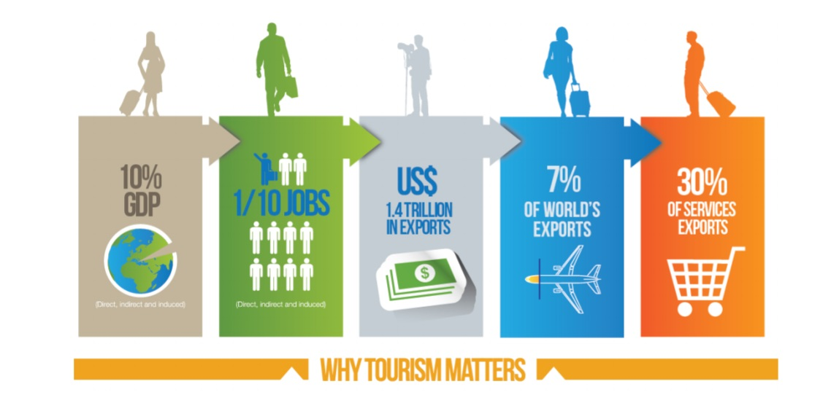

Slide 6
Challenges
1. Expected almost double growth in global tourism over the next 15 years
In 2030, the expectations are for 1.8 billion tourists per year (5 million daily) in international tourism and about 5-6 billion in domestic tourism
Major cause - Asian growing population and growth in Asian tourism to outward markets
2. Climate change and tourism
In Bulgaria - an expected extension of the summer season and a threat to winter tourism (shortening, especially at lower altitude resorts like Chepelare), water scarcity - a threat to golf tourism
On the other hand, according to a report by the European Commission in 2015, tourism in the long run will be among the most affected by climate change, along with Spain and Italy.
3. Tourism in the fight against poverty
10% of GDP globally, one in 10 jobs (a total of 230 million people in tourism), and in over 50% of developing countries it has been declared a priority area in the fight against poverty. Challenges - decent pay, working conditions.

Slide 7
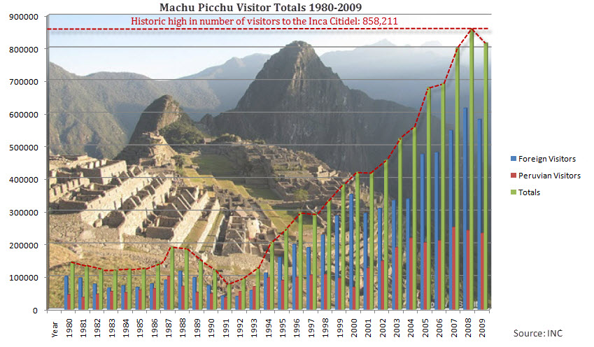
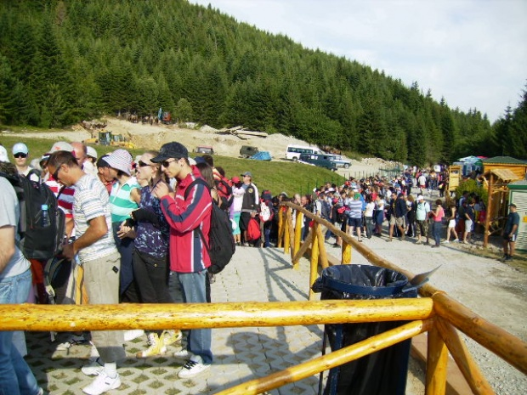
Overtourism
Machu Picchu
In 2012 – over 1 million tourists
Decision for limit: 2500 tourists/ day and 400 tourists/ day in the citadel but there are days with more than 4000 tourists.
Tourism companies declare that they need at least double the limit…
7 Rila lakes
Before the lift – 1000 tourists/ month
After the lift in 2009 – around 12 000 tourists/ month

Slide 8
How tourism can become sustainable
Adaptation in the changing conditions – climate changes, political conditions, etc.
Long – term planning taking into account all the positive and negative aspects
Involvement of all the stakeholders in the process of making decisions
Taking into account the capacity of a destination/ natural or culture attraction („Loving them to death“):
In ecological aspect – the extent to which an ecosystem can be used by tourism without threating it.
In socio – culture aspect – the extend to which the number of tourists threatens to change the local lifestyle and culture.
In psychological aspect – the extend beyond which there is no longer what attracted the tourists to one place – tranquillity, limited human impact, preserved nature, etc.

Slide 9
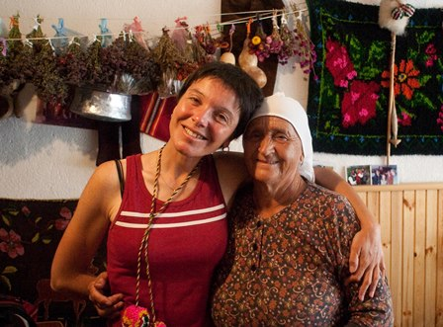
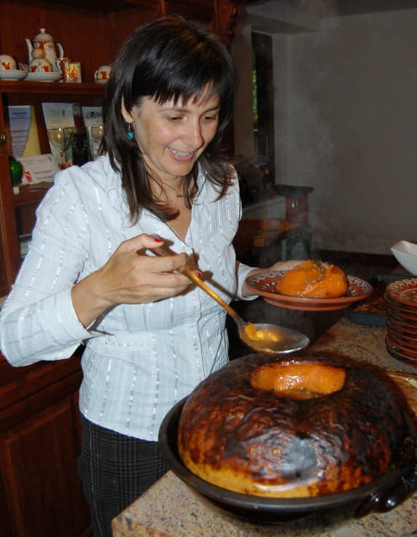
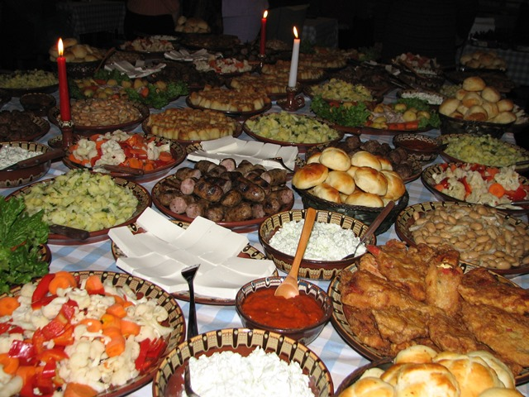
Accommodation and food
The principal “Love not Luxury“ – personal contact with the hosts
Local food, seasonal products – think about the food miles. Over 30% from the transport supports the food industry.
1 regular product in British supermarket travels around 1.500 km to the shelf.

Slide 10
Try to find a place that takes care of the nature and people

Slide 11
Transport
75 % of the emissions in the tourism are from the transportation
Choose to travel slowly, try to find alternatives when it is possible
There are different ways to lower your footprint

Slide 12
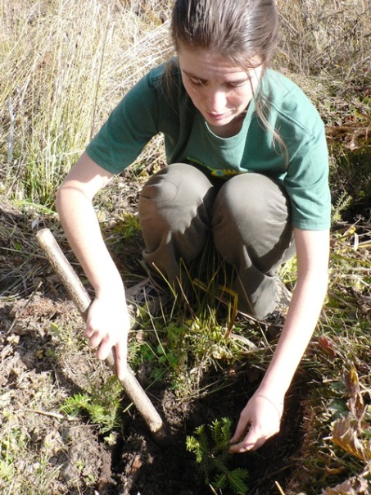
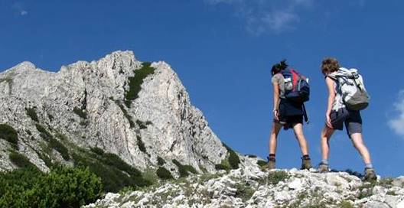
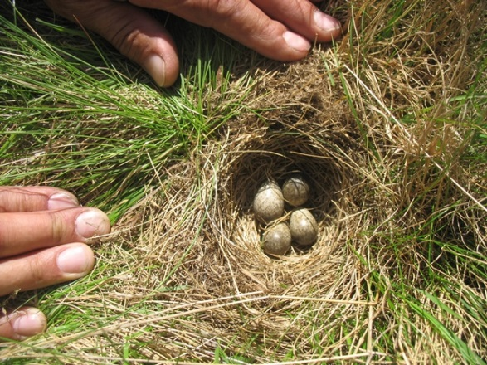
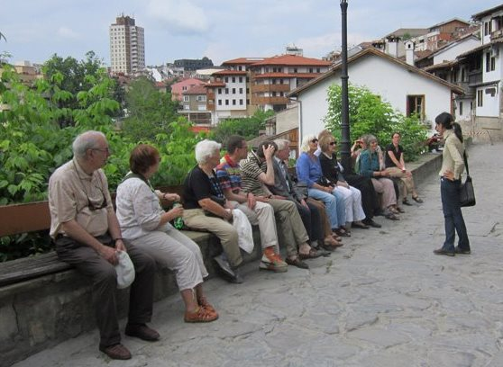
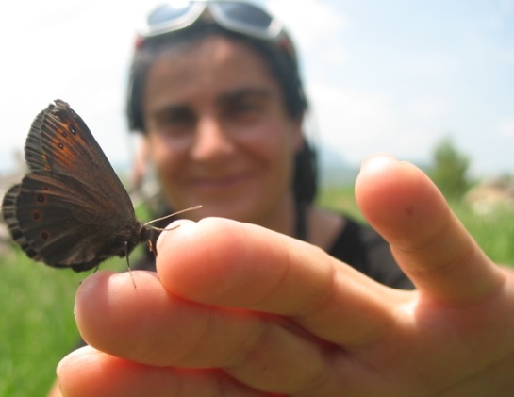
Communication with the tourists
The guides are our ambassadors

Slide 13
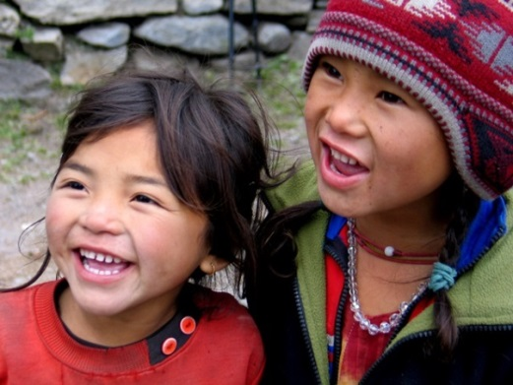
Local partner organizations
Choose the right partner – engagement with the sustainable tourism principals, licences and labour conditions (no exploitation of children and other)
Communication with the partners, motivation and education
Contracts with the partners – key clauses (child labor, anti-corruption, waste management and biodiversity protection)

Slide 14
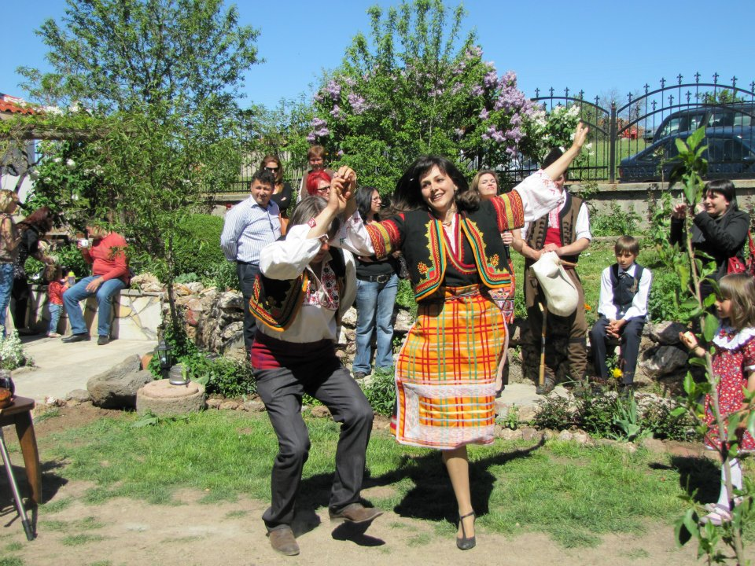
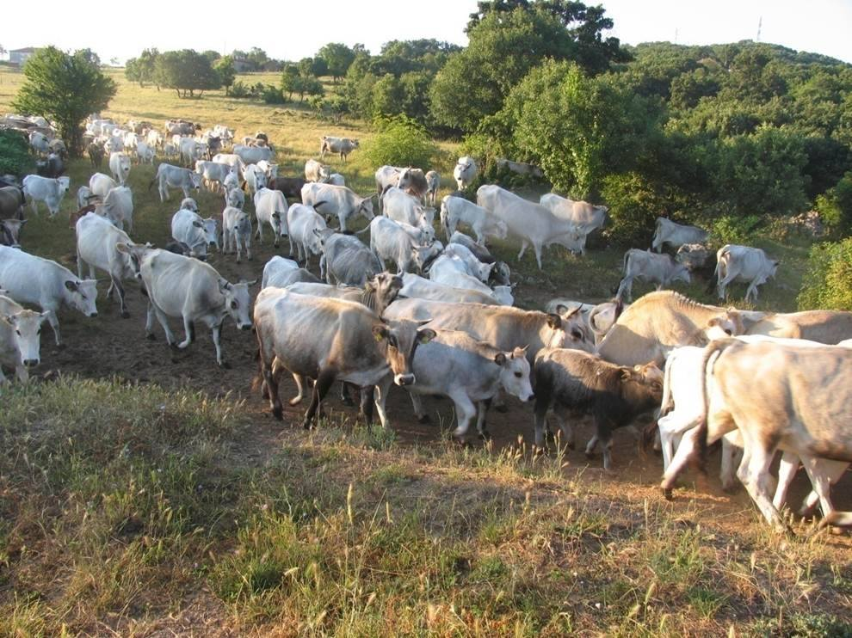
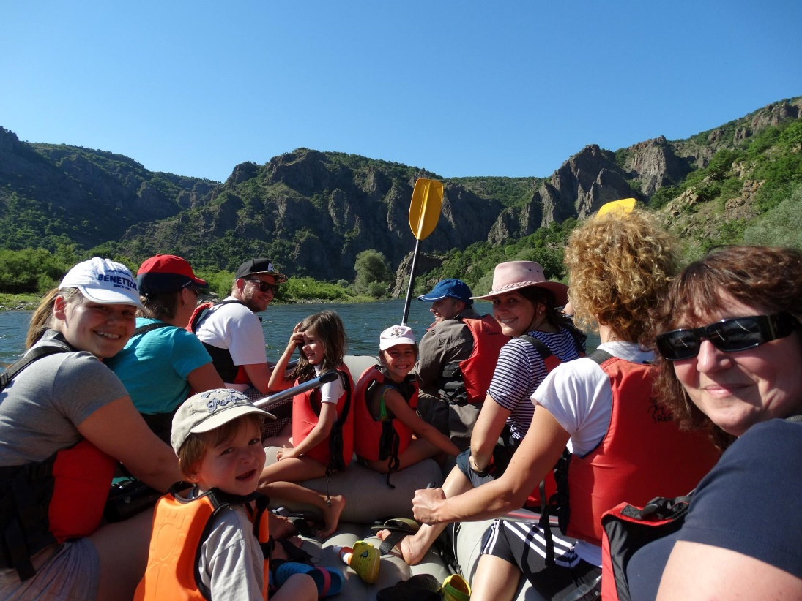
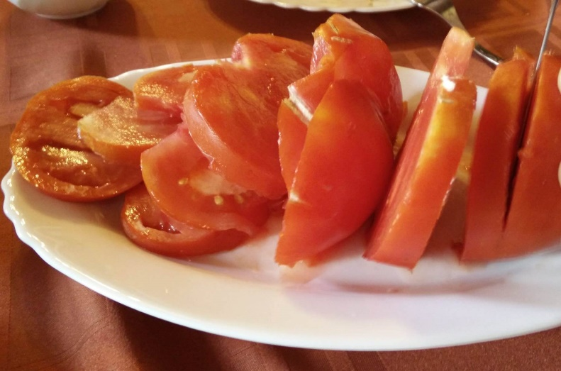
Best practices from Bulgaria Wild Farm in Eastern Rodopi

Slide 15
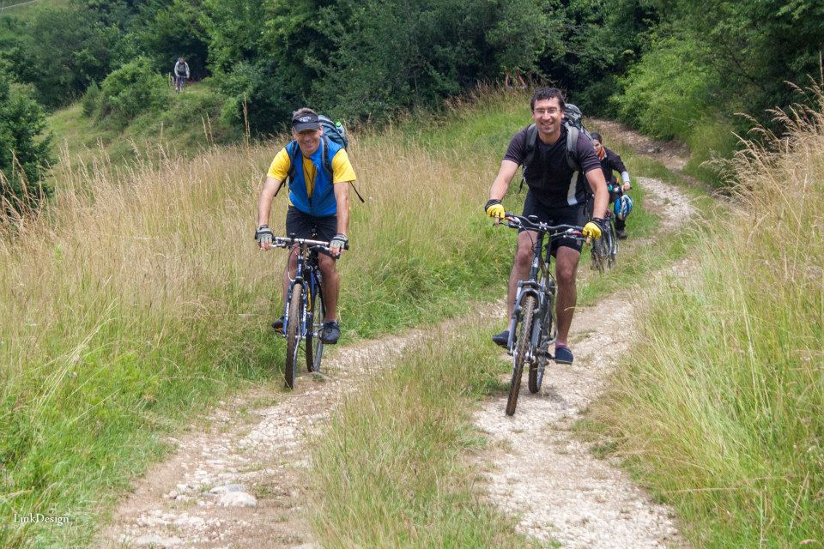
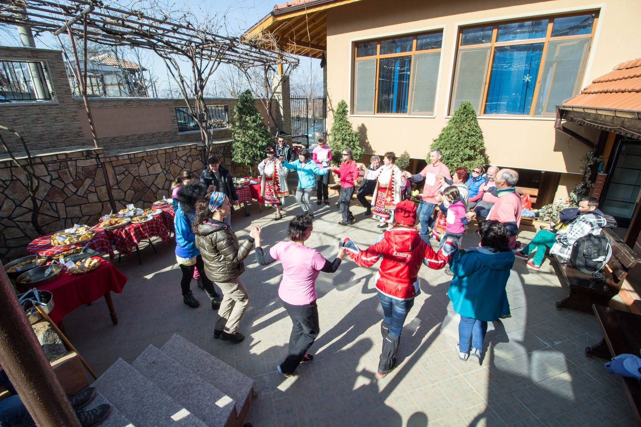
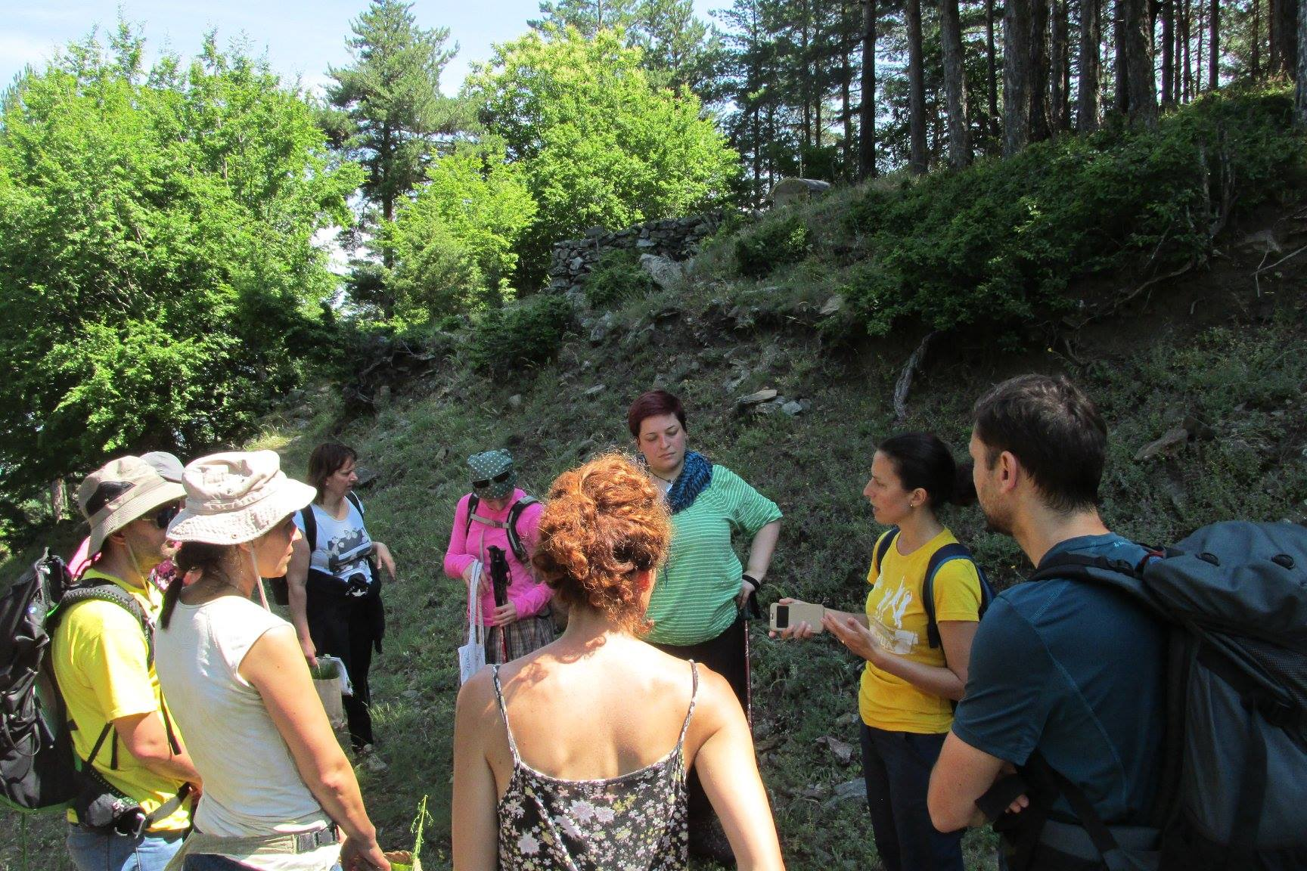
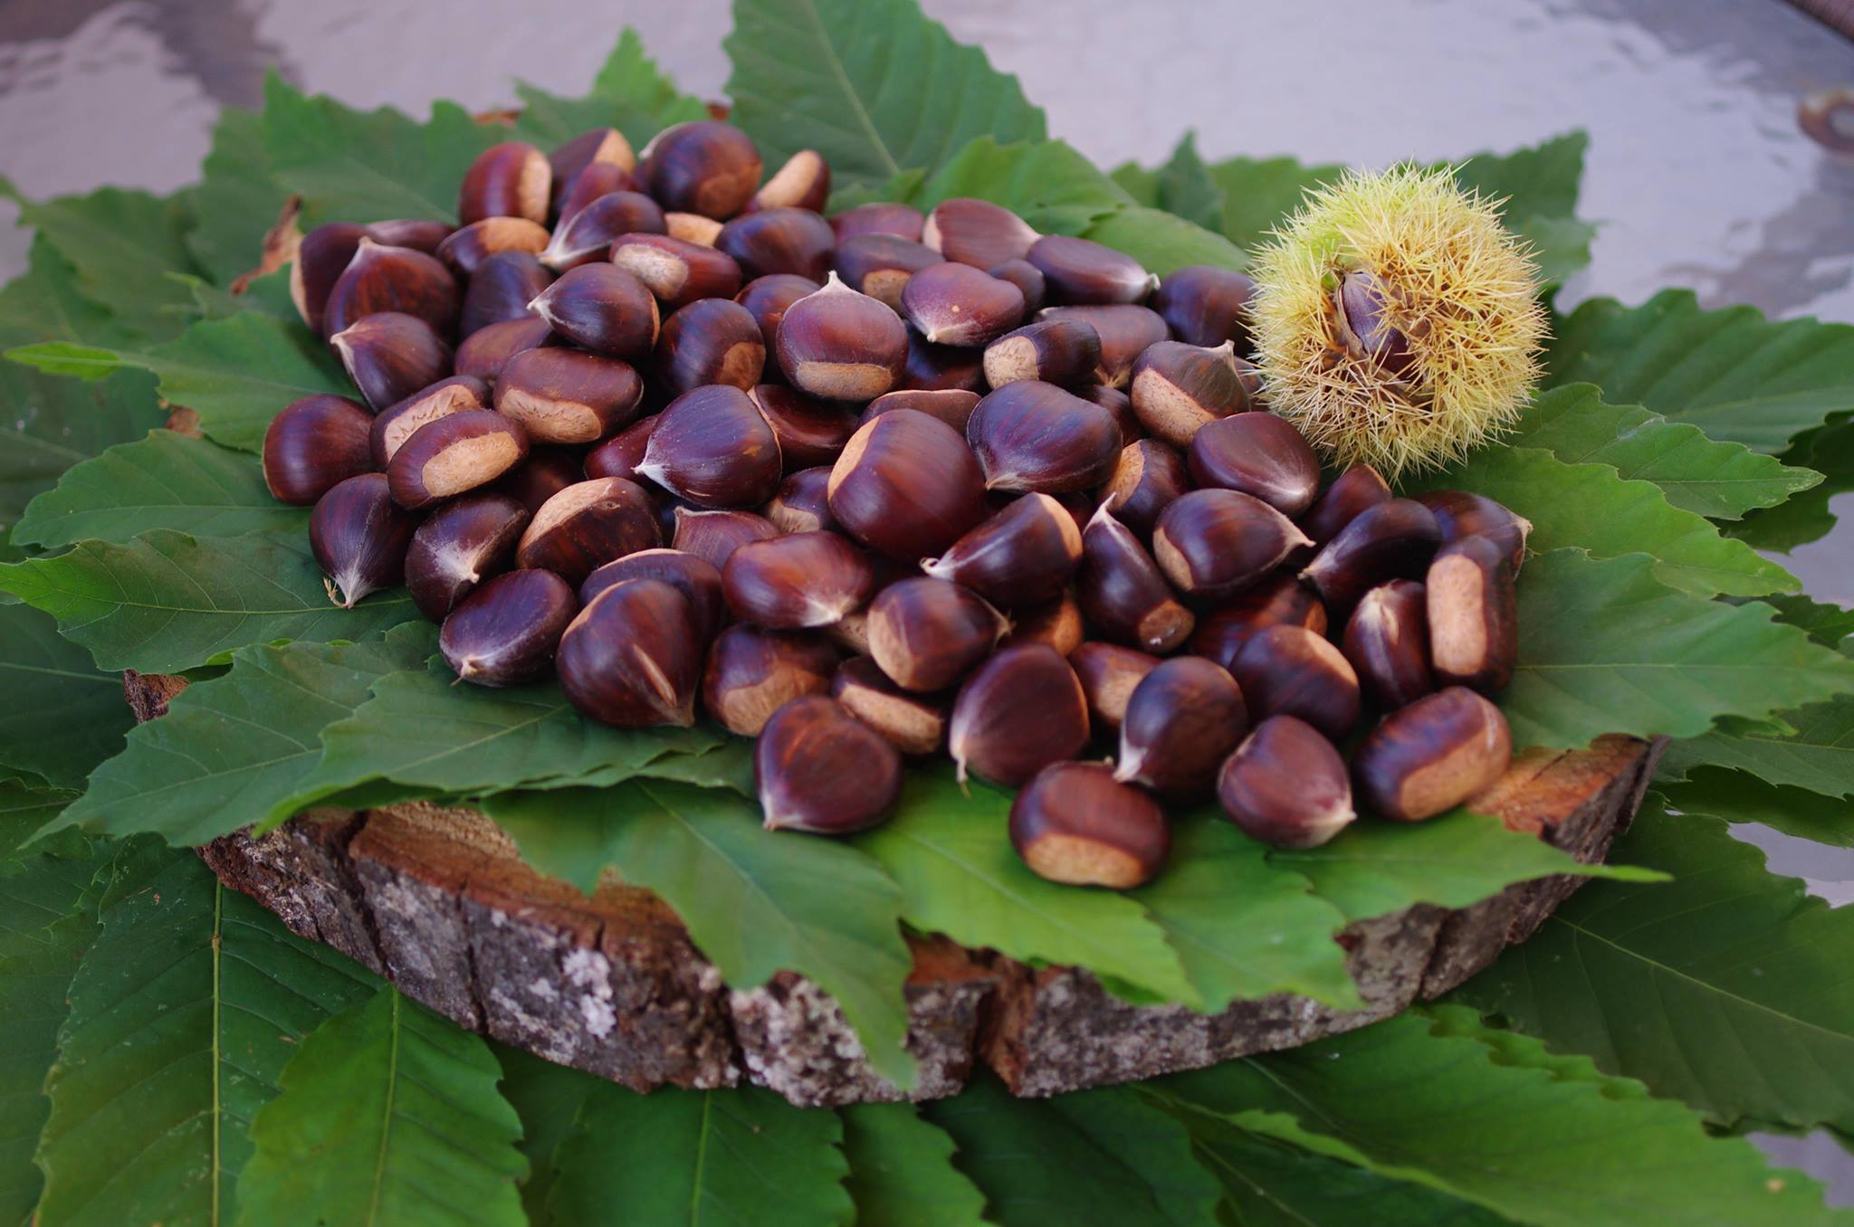
Best practices from Bulgaria Nature park Belasitsa

Slide 16
Travel sustainable. Keep in mind that we need to be responsible for our choices. Eleonora Yosifova baatbg@gmail.com www.baatbg.org

