Slide 1
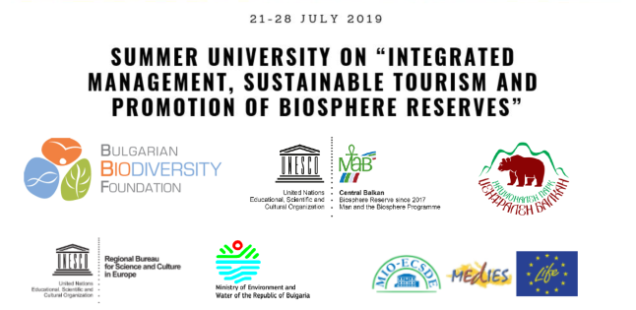
Exchange of experiences and peer training among local stakeholders in BRs
Dott. Filippo Lenzerini – filippo@punto3.it

Slide 2

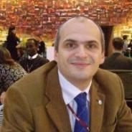
Dott. Filippo Lenzerini
Founding member of Punto 3 s.r.l., it operates in the field of UNESCO awards, territorial marketing and strategies of sustainable economic development for Protected Areas and high environmental and cultural value territories.
www.punto3.it
Currently I collaborate with several Italian Biosphere Reserves such as:
Appennino Tosco Emiliano,
Delta del Po,
Tepilora, Rio Posada e Montalbo,
Alpi Ledrensi e Judicaria,
following their branding strategy, construction of management plan, communication projects, involvement of local businesses.
I have been in charge of the candidacy dossier of Appennino Tosco Emiliano and Tepilora Rio Posada e Montalbo, currently I’m attending to the candidatures for MAB UNESCO of Gargano (Puglia) and Monte Grappa (Veneto).
I supervised the participatory process of the "MaB Youth World Forum" 2017 and co-organized several UNESCO MAB Summer Schools on the themes of rurality and sustainable tourism.

Slide 3
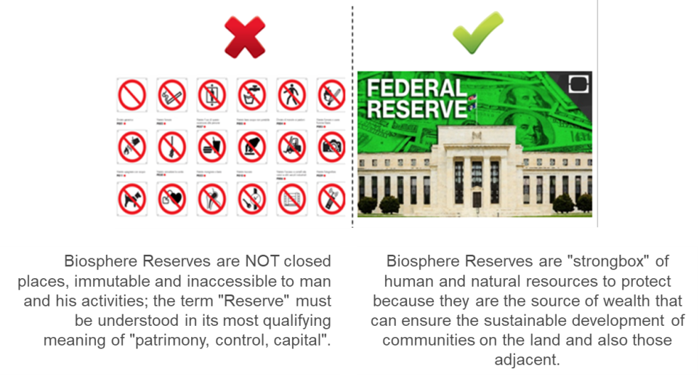
BIOSPHERE RESERVE

Slide 4
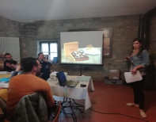
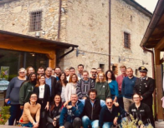
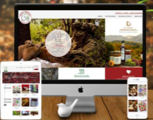
THE SESSION WILL FOCUS ON
The session will focus on the opportunities that the international MAB network offers to BRs’ stakeholders
to share knowledge/experience,
to develop cooperation projects
to attract funds.
I will present to you some experiences …. you start thinking about new opportunities, later, during the Summer University activities we will try to go deep on them

Slide 5
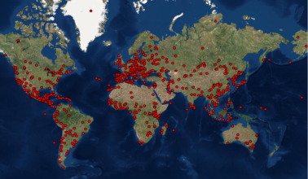
THE POWER OF THE NETWORK
701 Biosphere Reserves in the world
Each Biosphere Reserve has fields in which it excels in terms of conservation, development, support to knowledge.
Each Biosphere Reserve is required to make its excellence available to the rest of the MAB network (in this respect there is also a specific chapter in the application dossier).
Learning from each other, collaborating, acting together
this is the network’s Power.
Unfortunately, few Biosphere Reserves still operate in this way

Slide 6
DIFFERENT WAYS OF COOPERATION
Educational Tour
Training
Cooperation project
Knowledge exchange
A group of stakeholder from a BR visit an other BR with the aim of with the aim of living a direct experience on how specific projects are developed
A Biosphere Reserve offers, through its stakeholders, training to the MAB network on areas in which it has strong skills
Stakeholders of different Biosphere Reserves cooperate in the development of a common project that promotes the growth of each territory or or to enhance the results that can be added
The exchange of competences is carried out through workshops and conferences also with the aim of finding common solutions or building cooperation projects

Slide 7
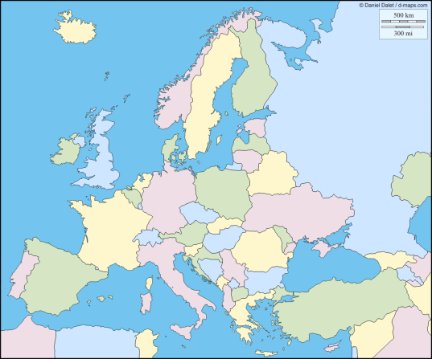
EDUCATIONAL TOUR: SWEDISH BRs IN APPENNINO
In the autumn of 2018 a delegation of 15 representatives of different Swedish Biosphere Reserves (and candidate territories) undertook an educational tour in Italy, in the Appennino Tosco Emiliano Biosphere Reserve

Slide 8
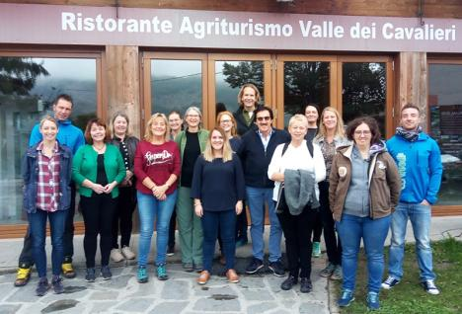
EDUCATIONAL TOUR: SWEDISH BRs IN APPENNINO
The educational tour was aimed at getting to know and deepening the "community cooperatives", an innovative experience born in very small villages of the Tuscan-Emilian Apennines, where entire communities come together in a social enterprise that in addition to producing income and employment, offers services to residents that otherwise neither the public nor the private sector would be interested in providing.

Slide 9
EDUCATIONAL TOUR: SWEDISH BRs IN APPENNINO
In October 2019 the educational tour will be repeated: 18 new Swedish participants.
The focus will still be on "community cooperatives" but also on the. branding strategy of the Biosphere Reserve

Slide 10
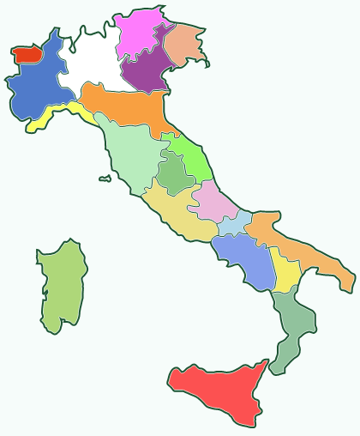
EDUCATIONAL TOUR: FROM APPENNINO TO ALPI AND BACK
two of the most active Italian Biosphere Reserves (Appennino Tosco Emiliano and Alpi Ledrensi e Judicaria) are organizing an exchange of educational tours aimed at small entrepreneurs:
to transfer skills to areas where each territory has excellence
to encourage the creation of cooperation between companies aimed at developing joint projects consistent with the UNESCO MAB programme.

Slide 11
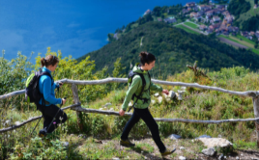
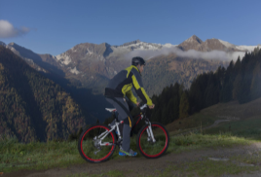
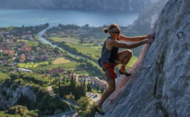
EDUCATIONAL TOUR: FROM APPENNINO TO ALPI AND BACK
in the first educational tour (October 2019), the Alpi Ledrensi and Judicaria Biosphere Reserve will host 15 outdoor tourism operators from the Appennino Tosco Emiliano and will offer them a training experience alongside their economic operators in the sector: Trentino is one of the most developed regions in the world in terms of outdoor tourism.
The educational tour also aims to explore the best ways in which outdoor sports activities can promote the enjoyment and knowledge of the territory and its values.

Slide 12
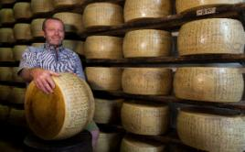
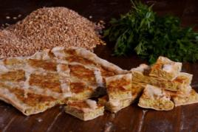
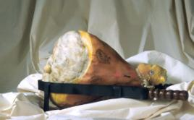
EDUCATIONAL TOUR: FROM APPENNINO TO ALPI AND BACK
In the second educational tour (Spring 2020), the Appennino Tosco Emiliano Biosphere Reserve will host 15 entrepreneurs in the agri-food sector from the Alpi Ledrensi and Judicaria and will offer them a training experience alongside their economic operators in the sector: Appennino has a very high experience in developing an high quality and strictly connected to the landscape agri-food productions.
The educational tour also aims to explore the best ways in which high quality agri-food products could be both useful to conserve landscape and biodiversity and to promote worldwide the Biosphere Reserve values.

Slide 13
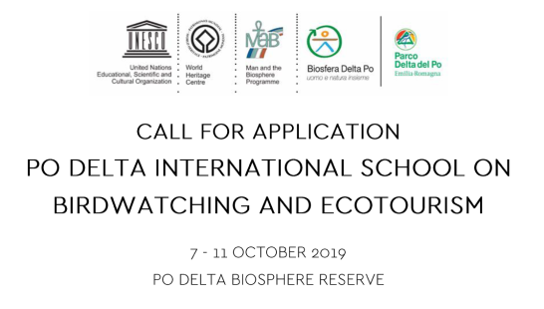
TRAINING: BIRDWATCHING AND ECOTOURISM

Slide 14
TRAINING: BIRDWATCHING AND ECOTOURISM
Po Delta has a long and valid experience in the field of birdwatching
With this school the BR would like to share its specific knowledge to the MAB network, mainly to those natural areas which wish to create or enhance an eco-touristic strategy based on birdwatching.
The school is structured both in lessons and in trips on the territory

Slide 15
TRAINING: BIRDWATCHING AND ECOTOURISM
Main target participants are:
Tourist operators already operating in the field of birdwatching and ecotourism who wish to improve or tourist operators who wish to diversify their activities in the field of birdwatching and ecotourism;
Administrators and officers of Public Administrations in territories and natural areas where birdwatching and ecotourism can be developed;
Directors or employees in tourist destination management organization (DMO) interested in developing birdwatching and ecotourism.
Application deadline: 13rd September (for those who apply to the school before the 31st of July, there is a significant discount on the registration fee )

Slide 16
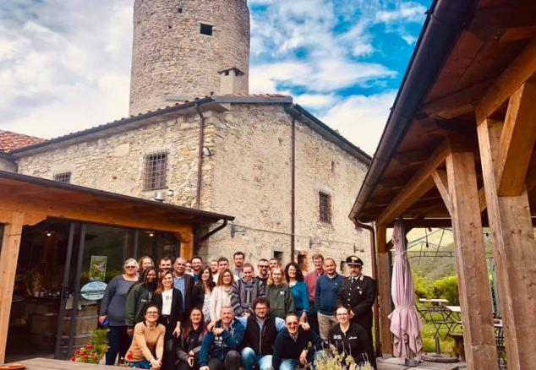
MEL
NETWORK OF BEEKEEPERS
IN MEDITTERRANEAN BIOSPHERE RESERVES

Slide 17
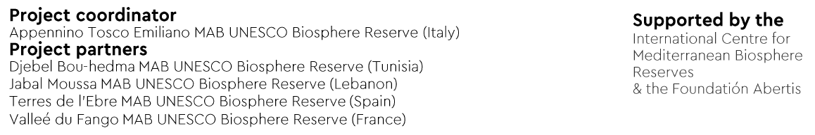
COOPERATION PROJECT: MEL
NETWORK OF BEEKEEPERS
IN MEDITTERRANEAN BIOSPHERE RESERVES

Slide 18
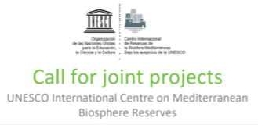
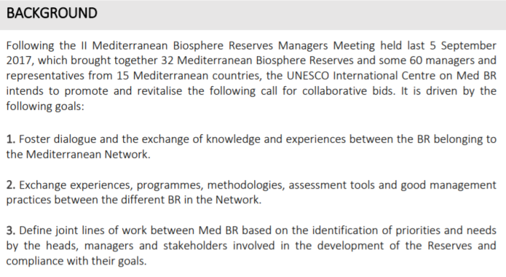
COOPERATION PROJECT: MEL

Slide 19
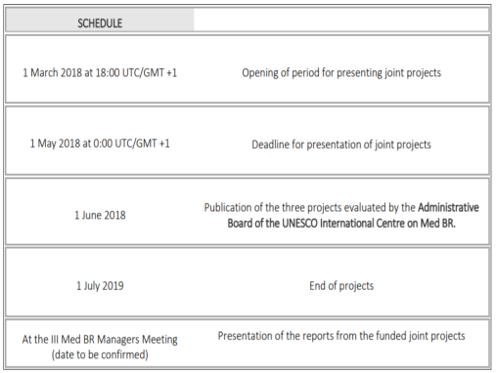
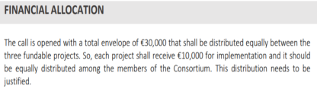
COOPERATION PROJECT: MEL

Slide 20
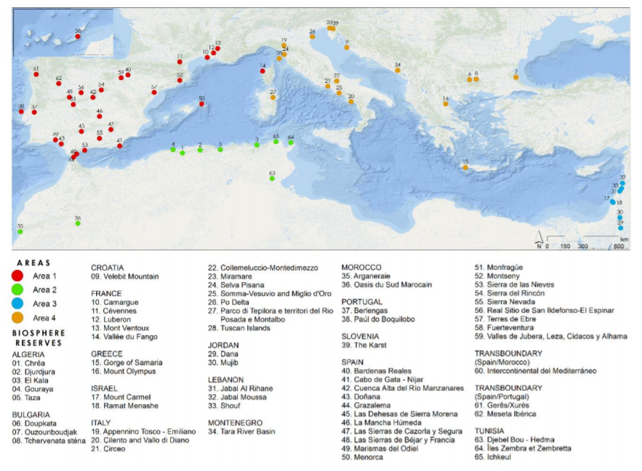

Slide 21
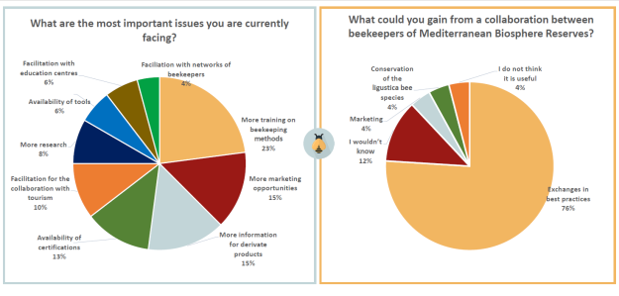
COOPERATION PROJECT: MEL
Main activities:
A survey in English, French, Arabic, Spanish, Catalan and Italian spread across the Mediterranean Network of Biosphere Reserves
135 responses from beekeepers of diverse Mediterranean Biosphere Reserves from Italy, Spain, France, Lebanon, Tunisia and Greece

Slide 22
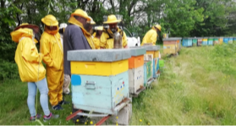
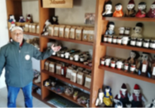
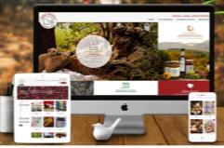
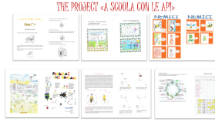

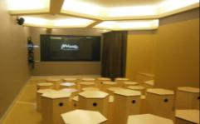
COOPERATION PROJECT: MEL
Main activities:
Awareness raising and local involvement events
Identification of good practices and experiences from partner Biosphere Reserves

Slide 23

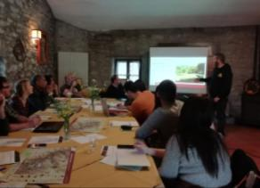
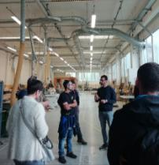
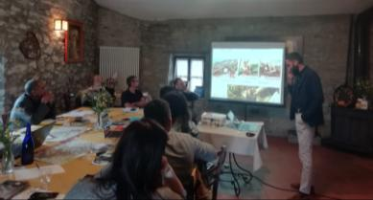
COOPERATION PROJECT: MEL
Main activities:
International Workshop "Honey production in the Mediterranean BRs“;
Held in the Appennino Tosco Emiliano Biosphere Reserve from the 27th to 29th May 2019 with delegations from all partner Biosphere Reserves
3 days of workshop and study visits on several thematics connected to beekeeping:

Slide 24
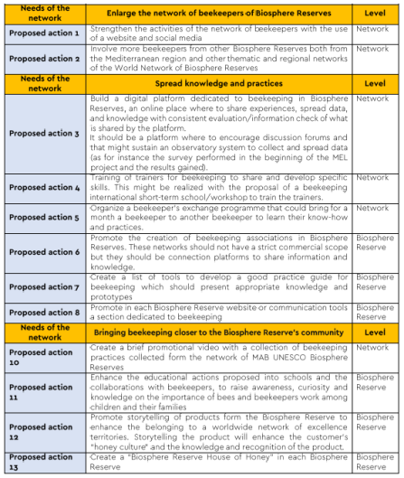
COOPERATION PROJECT: MEL
Main activities:
Development of the "network of beekeepers in the Mediterranean Biosphere Reserves"

Slide 25






EuroMAB2019
Gastronomic Contest at Km0
Between Italian Biosphere Reserves

Slide 26

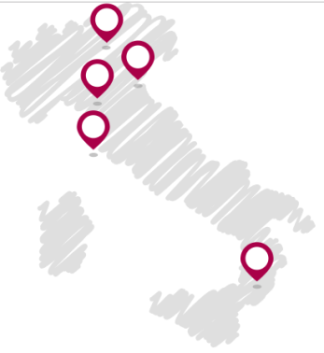
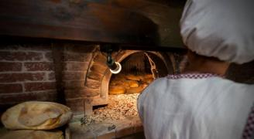
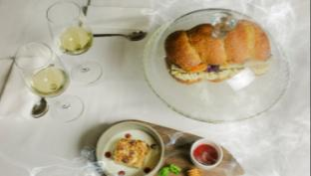
What is UPVIVIUM
UPVIVIUM is the gastronomic contest that involves restaurateurs and food producers of 5 Italian Biosphere Reserves: areas of vast culinary excellences, of high quality agricultural products which crop cultivation is closely linked to the conservation of the landscape and environment.
UPVIVIUM is a small network of Biosphere Reserves, diverse between territory and culture nonetheless united by the same purpose: the enhancement of products that are Km0 and the conservation of both breed and cultivated biodiversity.
7
Ledro Alps and Judicaria
5
Delta Po
15
Appennino Tosco Emiliano
2
Tuscan Islands
7
Sila
Numbers of the current 2018/19 Edition
Producers
involved
More than
100
36
Restaurants
in competition

Slide 27
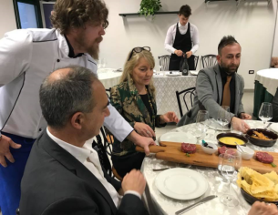
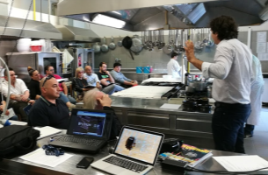
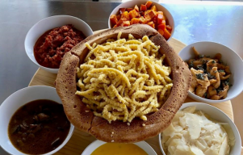
Purposes of the project
Favour the use of local products in the restaurants
Create and enhance long lasting connections between local producers and restaurants
Raise awareness of restaurateurs on the value of local food products in their menus and in storytelling
Preserve “cultivated and farmed” biodiversity
Stimulate sustainable tourism related to gastronomy
Promote with synergy Italian Biosphere Reserves

Slide 28
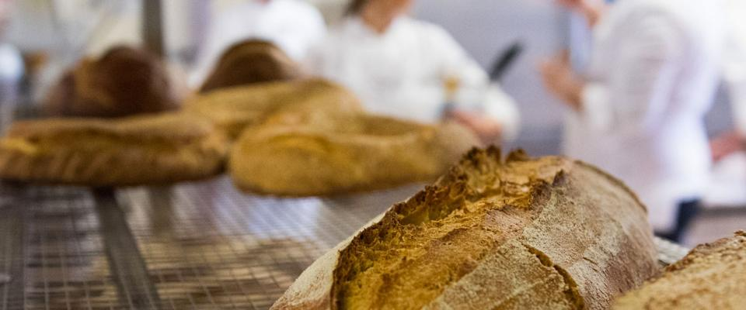
2018/19 Edition Theme: «Bread»
Bread is the leitmotif of different civilizations and an identity element of the Italian culture in the world.
The 2018/2019 Edition of the contest focuses on bread, accompanied food and traditional recipes, where bread is a key ingredient. The objective is to enhance the agro-food heritage of UNESCO MAB Biosphere Reserves.

Slide 29
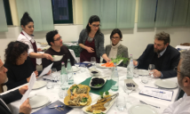

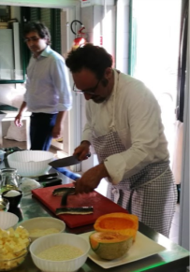
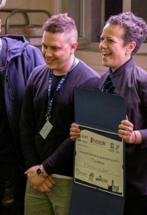
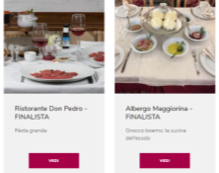
Timeline in the 2018/19 Edition
ALMA, the most influential training center - the International School of Italian Cuisine.
Located In Colorno (PR) and partner Of Parma UNESCO Creative City For Gastronomy
Training of participating restaurateurs
Tasting of the «UPVIVIM Menu» every weekend with online voting
Local finals inside Hospitality Schools of the Biosphere Reserves
National final at ALMA The International School of Italian Cuisine
October - December 2018
February - April 2019
May 2019
June 2019

Slide 30

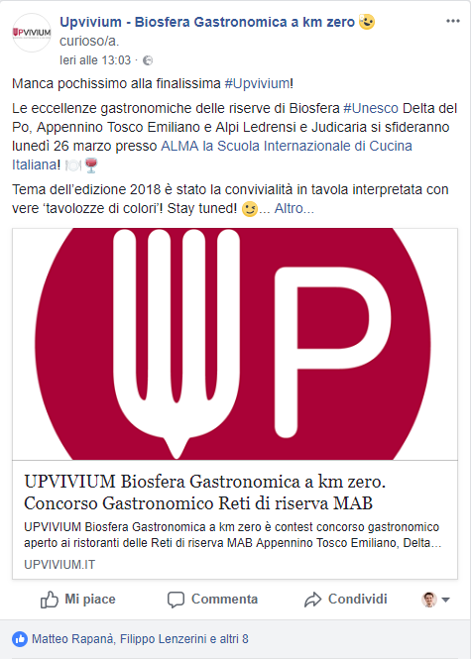
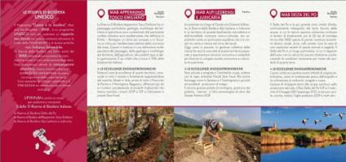
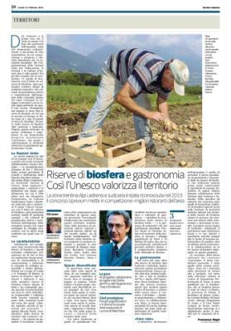
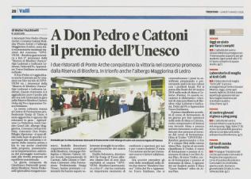
Communication tools of the Contest
Official Website
Social media as Instagram, Facebook
Social media advertising campaigns
Newsletter
News on specialized media for gastronomy
News in local media

Slide 31
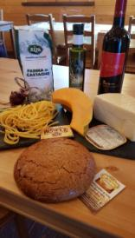






Future ambitions for UPVIVIUM
Enlarge the network of Biosphere Reserves adhering to the project both in Italy and in the WNBR
Boost the popularity of the Contest by turning it into a more and more known, awaited and esteemed appointment
Increase the number of participating restaurants and producers to enhance the positive impact of the project

Slide 32

KNOWLEDGE EXCHANGE: EEL CONSERVATION
The Po Delta Biosphere Reserve organized an international conference with aim to encourage the exchange of experiences, concerning eel conservation and traditional fishing.
4 BRs (ITA, FRA, SPA, SWE) presented the different strategies adopted in their territories.
Now those BRs are applying together a LIFE project on this issue

Slide 33

KNOWLEDGE EXCHANGE: EEL CONSERVATION
Thanks to the conference BRs understood a possible solution could be a good mix of:
creation of safe passages across dams,
the renaturalisation of some stretches of river,
the collaboration and cooperation with local fishermen
awareness actions on the eel as a vital resource of territories both of biodiversity and tradition.
Now those BRs are applying together a LIFE project on this issue

Slide 34

KNOWLEDGE EXCHANGE: BRANDING STRATEGY
The Appennino Tosco Emiliano Biosphere Reserve organized an international workshop with aim to acquire knowledge in order to define their own branding strategy, especially in relation to agri-food products.
9 BRs (ITA, AUT, SPA, JAP, PRC, GER, UK, KEN, MAR) presented their experience and approch

Slide 35


KNOWLEDGE EXCHANGE: EEL CONSERVATION
Thanks to the workshop experience now the Appennino Tosco Emiliano BR has defined its own branding strategy
….but about this we will tall about next time…

Slide 36
Thank you
for your attention
Any question?
Dott. Filippo Lenzerini
+39.3471620064
filippo@punto3.it

